Slide 1
Global Supply Chain Management Simulation: Strategic Insights from 4-Year Performance
Omkar Shashank Pathare, 20028753 M.S. Data Science | Stevens Institute of Technology Course: BIA 674A – Supply Chain Analytics

Slide 2
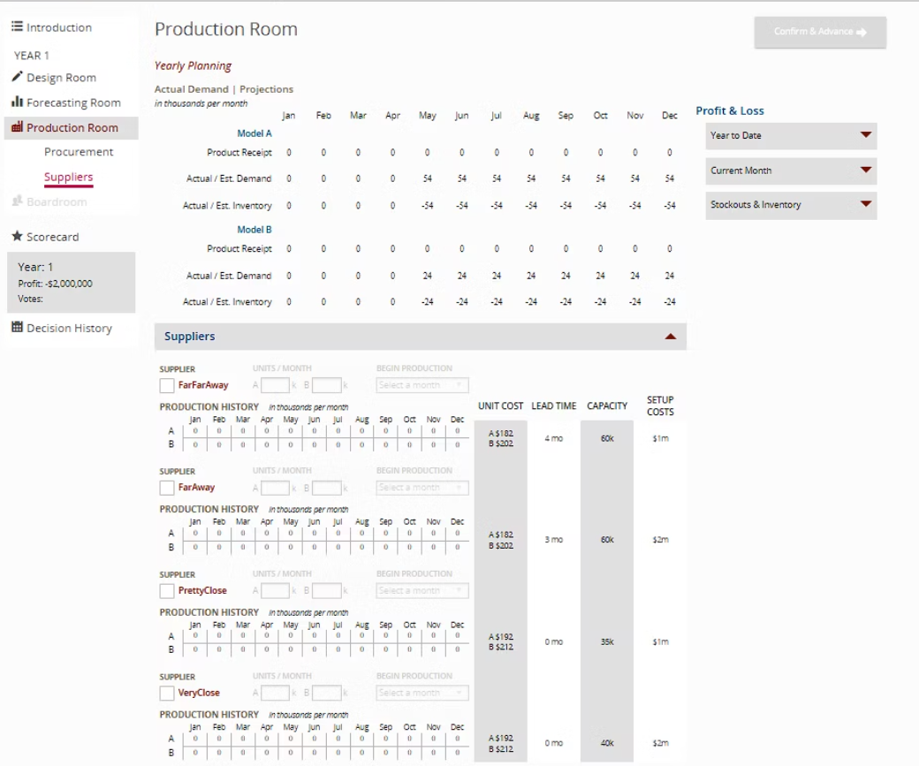
Production Room
Year 1 began with no production or supplier contracts in place.
Forecasted demand was set at 54k for Model A and 24k for Model B monthly.
No inventory or receipts were recorded for the year.
Supplier selection included four options with varying cost, capacity, and lead time.
No units were scheduled for production, causing risk of unmet demand.
The setup cost of each supplier varied significantly, influencing decisions.

Slide 3
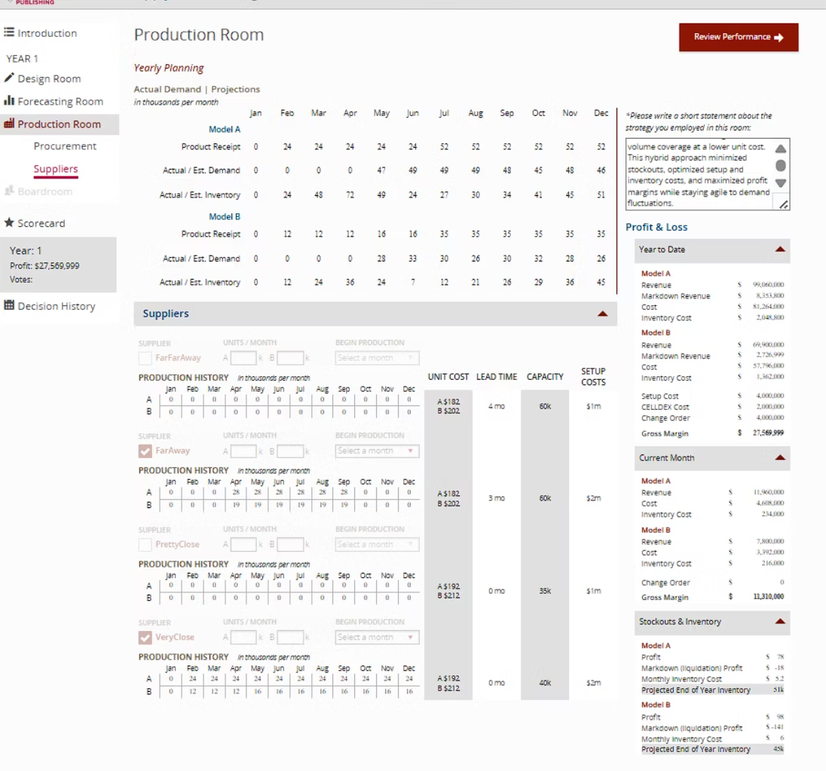
Production Room (After Setup)
Production began using all four suppliers to balance cost and agility.
Forecasted and actual demand aligned well, reducing stockouts.
Gross profit was $27.5M; Model A contributed higher revenue.
Cost efficiency was maintained through diversified sourcing.
Inventory holding costs and markdowns were minimized.
Strategy focused on lowest per-unit cost with buffer stock planning.

Slide 4
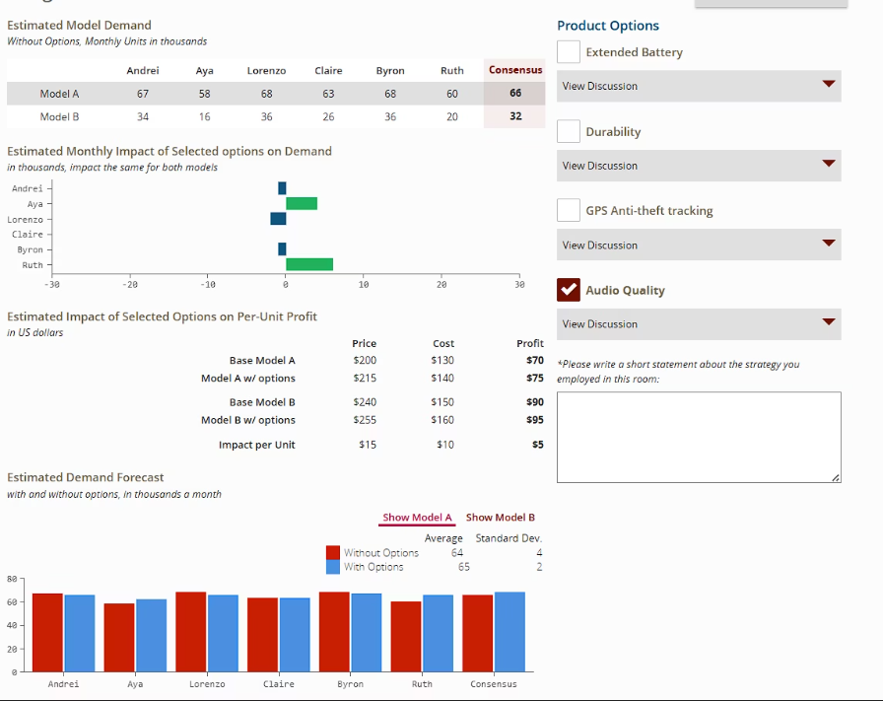
Design Room: Audio Quality Option
Audio Quality selected as the only product option for differentiation.
Model A and B received a small demand increase due to the option.
Profit per unit increased slightly for both models.
Segment-specific demand showed improvement for Ruth and Andrei.
Option added $15 cost but created $5 more profit for Model A.
Strategy focused on value-added features with minimal risk.

Slide 5
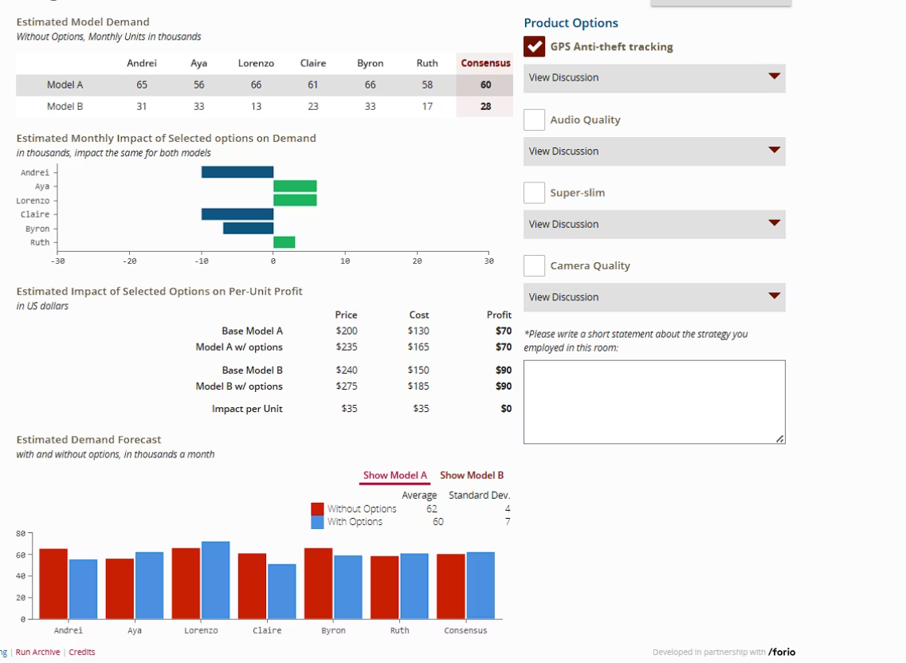
Design Room: GPS Anti-Theft Option
GPS Anti-theft option selected to boost Model B's segment appeal.
Option increased demand, particularly for Aya and Byron segments.
No increase in profit margin due to matched cost and price gain.
Demand forecast adjusted slightly downward from earlier.
Used to boost differentiation in a highly competitive market.
Strategically applied to low-performing Model B to stimulate sales.

Slide 6
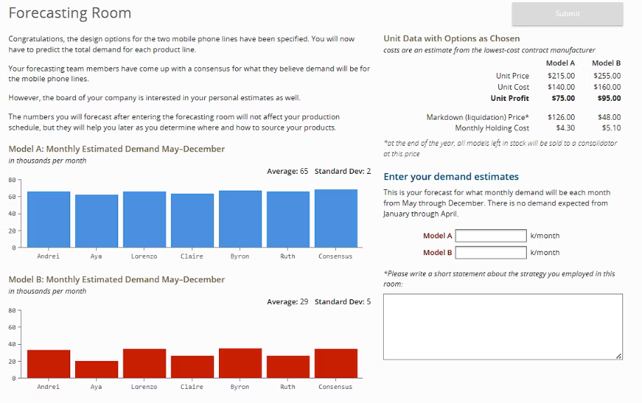
Forecasting Room: Demand Inputs
Forecast room averaged Model A demand at 65k, B at 29k units/month.
Low standard deviation showed consistent expected demand.
Forecast was aligned with product option impact and board consensus.
Pricing strategy ensured a $75 (A) and $95 (B) unit profit.
Liquidation and holding cost data aided inventory planning.
User entered forecasts for May–December demand planning.

Slide 7
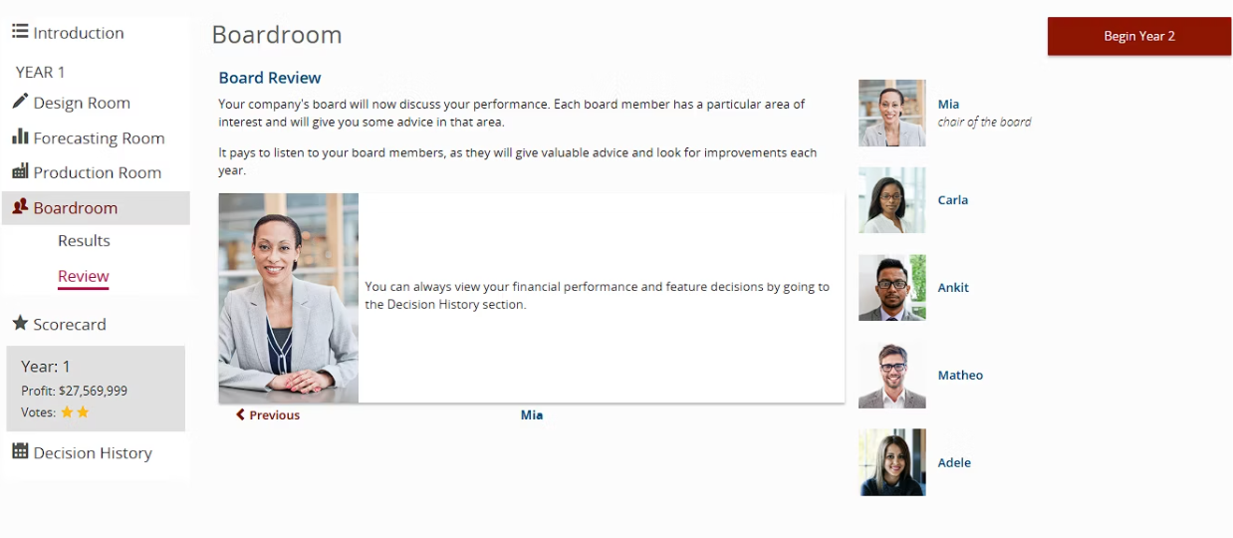
Boardroom Review (Year 1)
Boardroom review showed a profit of $27.5M for Year 1.
Mia, the Chair, encourages reviewing decisions for improvement.
Mixed star rating suggests balanced board sentiment.
Emphasis on reviewing financial performance and board suggestions.
Individual board members specialize in different strategic areas.
Encouraged to improve forecasting and demand planning for next year.

Slide 8
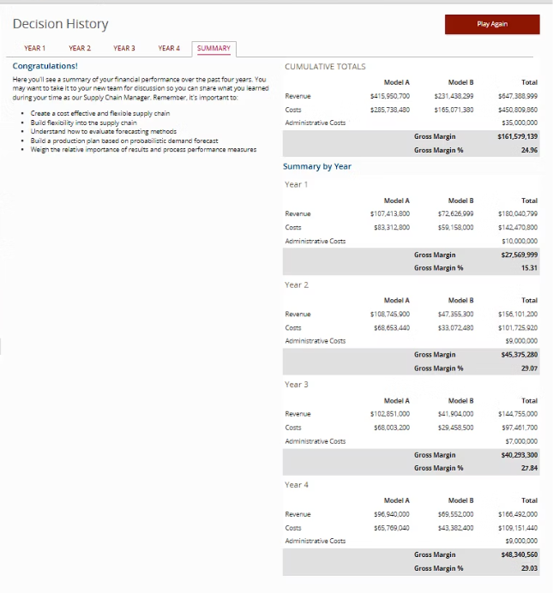
Decision Summary (Years 1–4)
Decision history shows consistent profit growth over 4 years.
Gross margin peaked in Year 4 at $48.3M with 29.93% margin.
Model A consistently outperformed Model B in profit and revenue.
Year 2 had the highest leap in profits, indicating better alignment.
Steady administrative costs highlight control over overheads.
Takeaways included agility, supplier planning, and forecast accuracy.

